Slide 1
CS 203
Automatic
Attendance
System
DSA Project

Slide 2

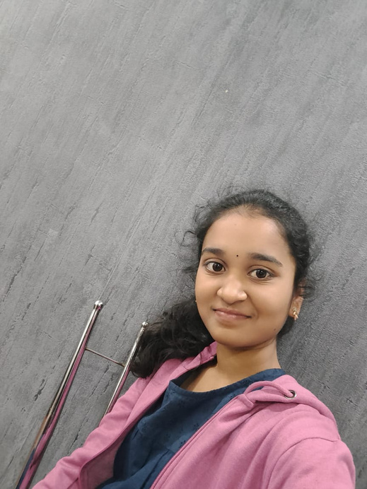
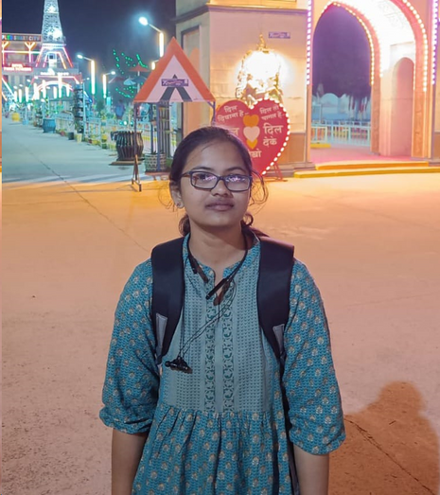
Team Leader
Team Details
Name : B.Rithvik
Roll no : 220001016
Feel free to reach out!
Team Member 1
Name : K.Tejaswini Raj
Roll no : 220001041
Team Member 2
Name : K.Sai Ruchitha
Roll no : 220001036

Slide 3
Introduction
The problem we are addressing is how to effectively and accurately
record student attendance by utilizing group photos as a source of information
We have developed a machine learning technique that uses hash maps to identify and log every student's attendance from group photographs.

Slide 4
Project Overview
Data Collection
Model
Website
Results
The raw data is collected and it is modified according to the requirement of the model and its working
After Pre-Processing , the stored encodings is used for further comparison and then result is written in csv file.
Our Website gives the csv file on submitting all the requirements mentioned and it is responsive type.
The accuracy is calculated accordingly and it is displayed below the respective group photos.

Slide 5
Libraries Imported
Face Recognition
Pickle
os

Slide 6
Extraction of Face-encodings
The face encodings of each student’s reference photos are extracted using the face recognition module.
These encodings are stored in a python dictionary (hash map) with key values as roll numbers of the students.
This dictionary is then dumped into a pickle file, so we need not extract the reference encodings every time.

Slide 7
Working principle
We initialize a dictionary named attendance with key values as roll numbers and mark everything as absent.
The face encodings of each face in the group photo is extracted. We find the minimum distance of each faces with the reference faces extracted from the pickle file.
The roll number which gives the minimum distance is marked as present.
This attendance dictionary is written in a csv file

Slide 8
DataStructures Used
Dictionary
Lists

Slide 9
WebSite
Fill the requirements mentioned to know the attendance report
This option is for existing students or any other faculty member , Our Website asks for some requirements which includes uploading image and then after submission it gives us the attendance report in the form of csv file.
Now as we are interested to add details of newly registered student , so we are giving them this option to add their academic details and their individual pics so that their encodings directly goes to pickle file which will be used further in marking attendance.
Add Details for the students who are newly registered

Slide 10
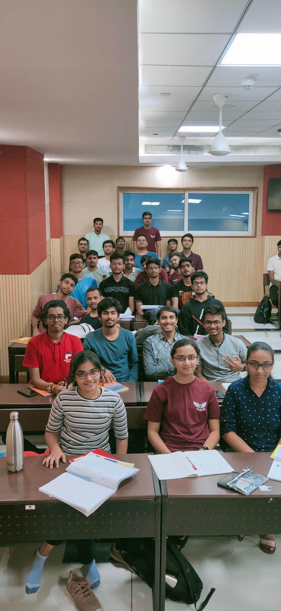
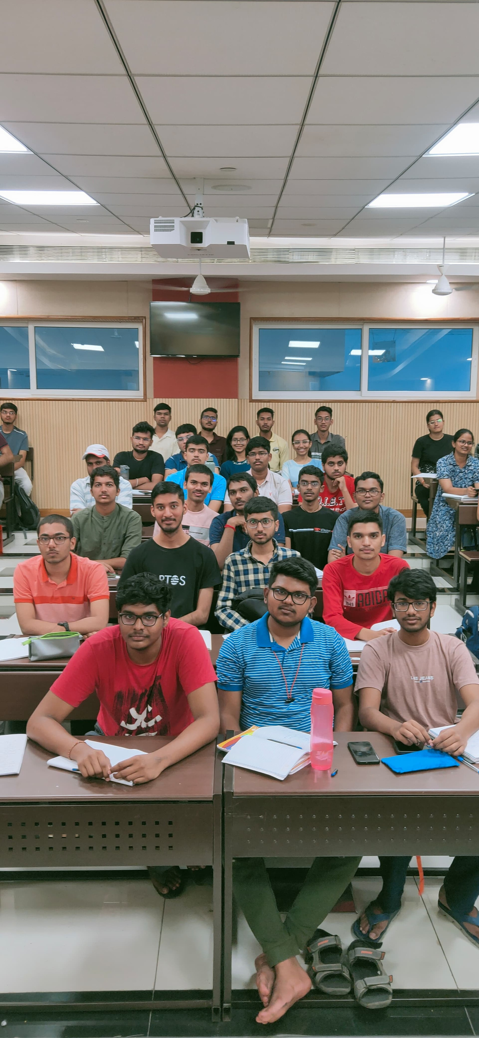
RESULTS
Accuracy : 91.34
Accuracy : 91.67

Slide 11
Python
HTML
CSS
JavaScript
Django
Tech Stacks

Slide 12
THANK YOU

